Slide 1

MY BILLBOOK
Bill Generated

Slide 2
ACKNOWLEDGEMENT
DR RISHU CHAUJAR
DEPARTMENT OF APPLIED PHYSICS , DTU
SUBMITTED TO:
PRESENTERS:
PULKIT PANDEY – 2K19/EP/076
YASH GUPTA – 2K19/EP/105

Slide 3
Table of Contents
01
02
03
04
OBJECTIVE
FEATURES
CODE REVIEW
SCOPE

Slide 4
01
OBJECTIVE

Slide 5




Reduces Human Labour
Increase Efficiency
Customer satisfaction
Data Retrivation

Slide 6
02
FEATURES

Slide 7
Manufacturing is more than just putting parts together. It’s coming up with ideas, testing principles, and the perfecting engineering, as well as writing code in assembly language.
Speed Optimization
Memory Efficient
Hardware Oriented
Embedded System
Less Instruction
Complex Jobs
BILL GENERATED

Slide 8
03
CODE REVIEW

Slide 9




WALK THROUGH THE CODE
USER OPTION
INPUT
EXECUTION
OUTPUT

Slide 10
04
SCOPE

Slide 11
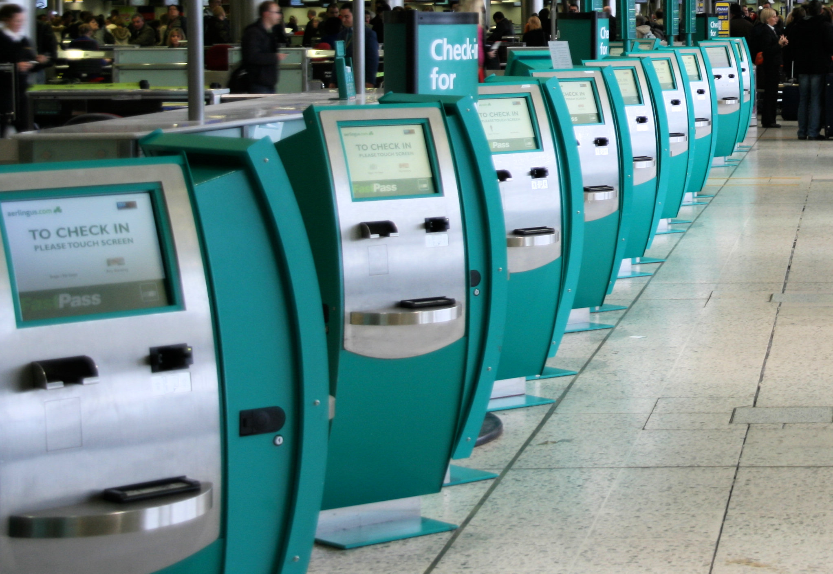
Self Check-in
self-check-in at a certain time prior to their boarding.
Using the airline check-in kiosks, passengers can choose their seat, check-in, and print their boarding passes many hours before departure.

Slide 12
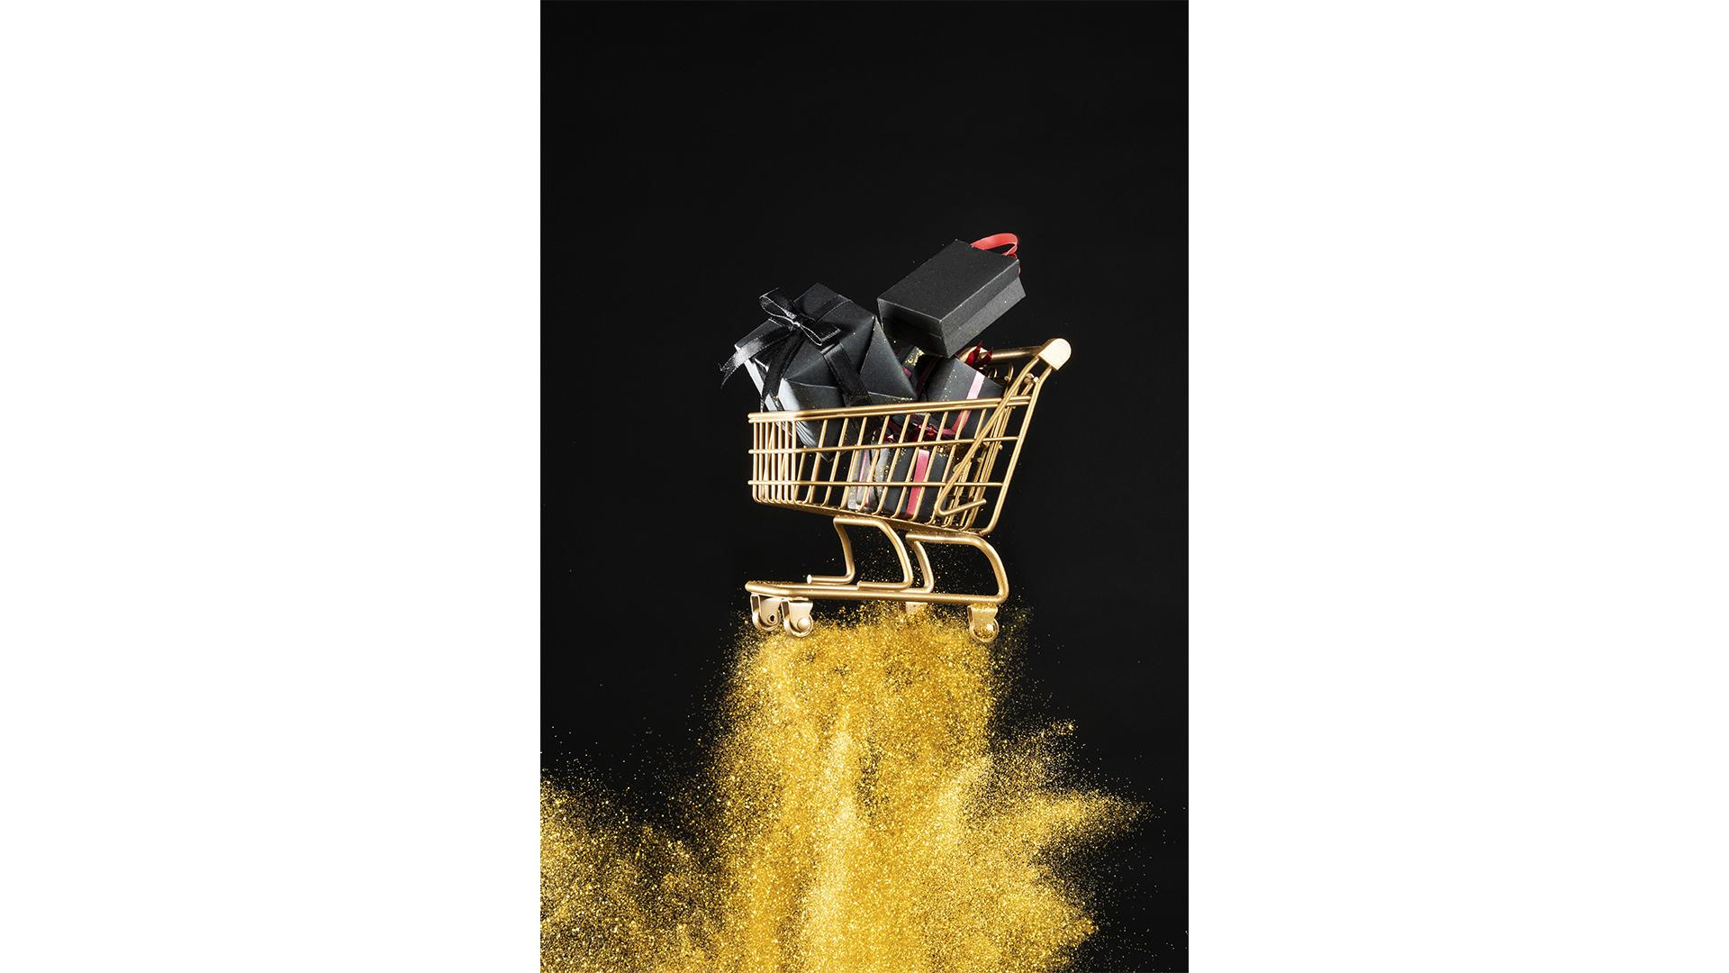
Bill-Generator
Bill Generator would act as a tool to take orders and generate bills without any hassle or error

Slide 13
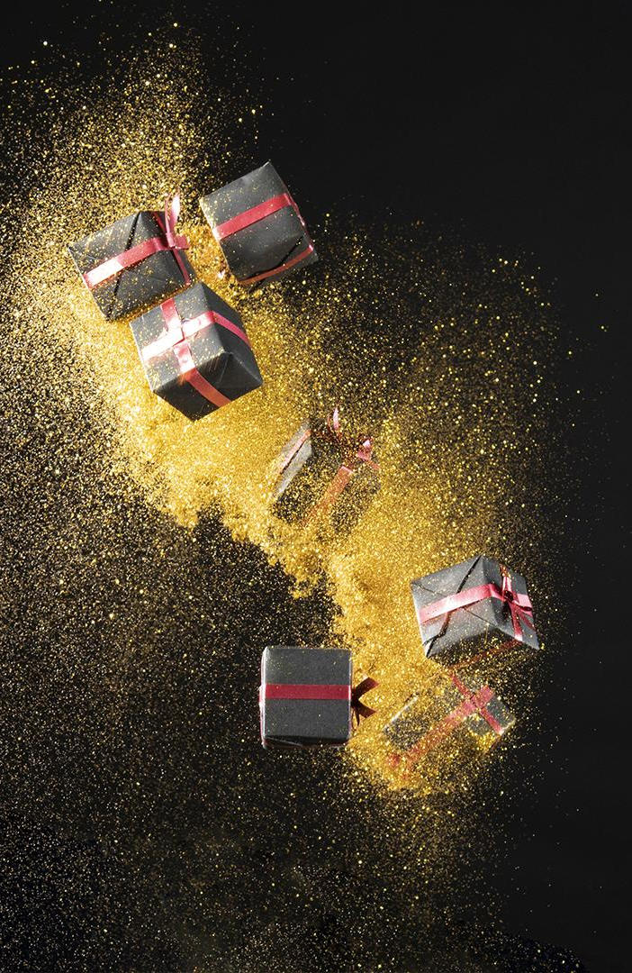
“THANK YOU”

